Slide 1

VOCATIONAL, PROFESSIONAL AND TECHNICAL EDUCATION
IN ROMANIA
PARTNER:
INSPECTORATUL ȘCOLAR AL MUNICIPIULUI BUCURESTI
(SCHOOL INSPECTORATE OF BUCHAREST)
ROMANIA

Slide 2
THE SYSTEM OF PRE-UNIVERSITY EDUCATION IN ROMANIA
IT IS STRUCTURED ON 4 LEVELS
PRE-SCHOOL EDUCATION
GYMNASIUM
(GRADE 5-8)
PRIMARY EDUCATION
(GRADE 1-4)
LOWER-SECONDARY
HIGHSCHOOLGRADE 9-10)
SECONDARY EDUCATION
UPPER – SECONDARY
(GRADE 11-12)
POST-SECONDARY
EDUCATION

Slide 3
HIGHSCHOOL ADMITTANCE
The pupils who graduate the 8th grade take part in the National Evaluation (exams that mean the summative evaluation of pupils’ competences acquired during their lower-secondary education – grades 5-8);
The admittance in high-school is not based on other exams, but on a grade (the average between the grade obtained at the National Evaluation and the average of the general grades of classes 5-8);
The pupils are distributed in high-schools through a computerized process based on the forms with pupils’ options filled in by their parents.

Slide 4
HIGHSCHOOL ADMITTANCE
GYMNASIUM GRADUATES CAN CONTINUE THEIR EDUCATION IN:
HIGHSCHOOL
VOCATIONAL
HIGHSCHOOL
THEORETICAL
HIGHSCHOOL
TECHNICAL

Slide 5
HIGHSCHOOL – VOCATIONAL EDUCATION
Specializations:
Visual arts
Artistic
Music
Military
Sportive
Pedagogical
Theological
To be admitted in these classes, pupils must pass the specific exams to prove their abilities and competences in the domain.

Slide 6

Highschool - theoretical
Specializations:
- Mathematics – Computer Studies
- Natural Sciences
Humanistic studies
- Philology
- Social Sciences

Slide 7
HIGHSCHOOL – TECHNICAL EDUCATION
SPECIALIZATIONS:
Natural resources and environment protection (Domains: Agriculture, Food industry, Environment protection, Forestry)
Services (Domains: Commerce, Economy, Esthetics and Hygiene, Tourism and nutrition)
Technical (Domains: Industrial chemistry, Constructions, Electricity, Electric, Electro mechanics, Wood processing, Textile and leather industry, Construction materials, Mechanics, Media, Printing Industry)

Slide 8
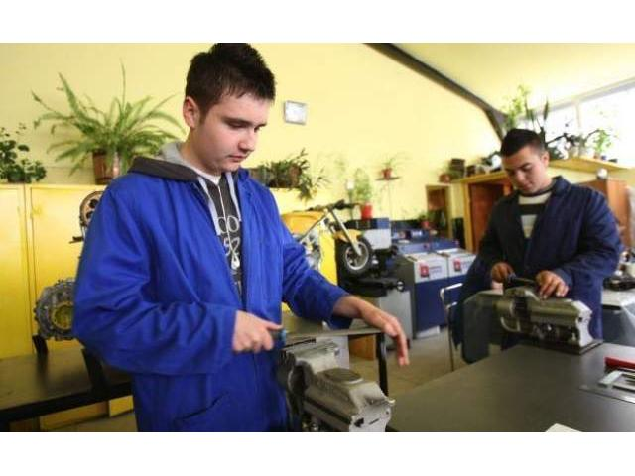
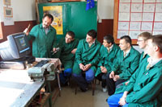
In technical high-schools, there is 37% of the total number of pupils registered in secondary education.
The number of technical high-schools represents almost one third of the total number of high-schools in Romania.

Slide 9
THE PROFESSIONAL AND TECHNICAL EDUCATION IN ROMANIA
In Romania, the qualification levels are set by the Decision of the European Council 85-368-EEC:
PROFESSIONAL EDUCATION gives the 2nd level of qualification = level 3 EQF;
TECHNICAL EDUCATION gives the 3rd level of qualification = level 4 EQF.

Slide 10
THE PROFESSIONAL EDUCATION IN ROMANIA
Starting with the school year 2012-2013, the professional education starts after grade 9 as a part of secondary education, technical specialization.
9TH GRADE
PROFESSIONAL STUDIES – 9TH GRADE
PROFESSIONAL STUDIES – 11TH GRADE
10TH GRADE
11TH GRADE
LABOUR MARKET
12TH GRADE

Slide 11
THE PROFESSIONAL EDUCATION IN ROMANIA
This new professional education is much closer to the employers’ needs and the needs of the present and future labour market.
Learners have the possibility to get trained in real life conditions, during their training stages in companies.
There are assured and organized only the qualifications asked for by the employers.

Slide 12
THE PROFESSIONAL EDUCATION IN ROMANIA
All learners in the professional education are given the “Professional Scholarship” – a monthly allowance.
Some of the employers have given their own scholarships to learners or other help (free meals, free transportation)

Slide 13
THE PROFESSIONAL EDUCATION IN ROMANIA
The employer has an important role from the moment when there are established the offers – the qualifications, then in the selection of pupils, learners’ practical training, etc.
The employer’s role ends in the moment of the graduation exam which is followed by issuing a certificate for professional competences (the qualification certificate).

Slide 14
CERTIFYING THE PROFESSIONAL QUALIFICATION
The exam for certifying the professional qualification is organized by the school which assured the learners’ professional education.
The exams are held at the companies/firms or partner institutions.
The examination committee has one representative of school and one from the company/partner institution.

Slide 15
THE PROFESSIONAL EDUCATION IN ROMANIA
The graduates of the 10th grade secondary education, technical studies, can choose to obtain the certification of a 2nd level qualification
9TH GRADE
10TH GRADE
PRACTICAL TRAINING SESSIONS (720 hours)
11TH GRADE
12TH GRADE
Labour market

Slide 16
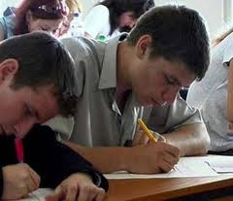
TECHNICAL EDUCATION IN ROMANIA
After passing an exam to certify their competences, the graduates of upper-secondary education get a 3rd level professional qualification (Technician).
They can register for the Baccalaureate examination – evaluation of competences, of the level of general knowledge and specialization of the high-school graduates.

Slide 17
TECHNICAL EDUCATION IN ROMANIA
The graduates of technical education have the following options:
Labour market
(aprox. 35%)
Post-secondary education
(aprox. 9%)
Higher education
(aprox. 56%)

Slide 18
EDUCATION FRAMEWORKS
They establish (for each grade) the compulsory subjects and the number of classes per week allotted for these subjects and for the practical training.
They specify the total number per week allotted for optional subjects (local development curriculum).
The Education Frameworks are made by the National Centre for Curriculum and Evaluation in Professional Education and they are approved by Ministry of Education

Slide 19
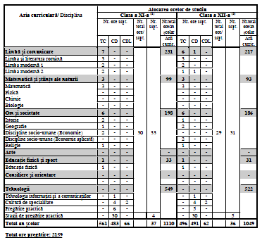
THE EDUCATION FRAMEWORKS
EXAMPLE:
The frameworks for upper-secondary education – technical high-school
Professional qualifications:
Technician in tourism
Technician in economy
Technician in administration

Slide 20
THE LEARNING PLAN
The Learning Plan is the document which establishes the necessary modules of the subjects contained in the Education Frameworks (specific subjects, practical training) according to the study year and professional qualification.
The modules refer to the units of competences contained in the Standards of Professional Training approved by the Ministry of Education after the consultations with the social partners.

Slide 21
The LOCAL DEVELOPMENT CURRICULUM
It’s a component of the National Curriculum that contains the classes allotted to the development of the institution, the educational offer is agreed by the partner firms.
During its classes, it is recommended to be done classes of practical training.

Slide 22
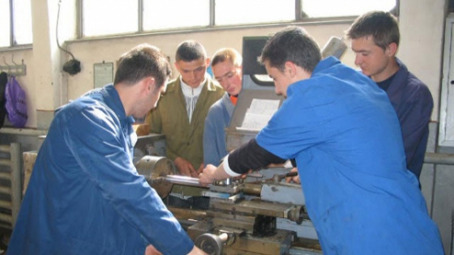
The LOCAL DEVELOPMENT CURRICULUM
It assures the frame for a training that alllows the acquisition of technical competences described in the Standards of Professional Training
It is given a flexible curricular frame that allows adjustment to the training needs identified on the labour market.

Slide 23
THE NATIONAL SYSTEM OF PROFESSIONAL EDUCATION AND TRAINING IN ROMANIA
Initial professional training
It is done in the pre-university education through:
- professional education
- high-schools (technical specializations) - post-secondary education
Continuous professional training (adult education)
It is done through: courses of initiation, qualification, specialization

Slide 24
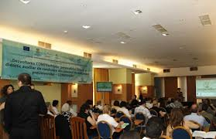
THE TRAINING OF TEACHERS IN PROFESSIONAL AND TECHNICAL EDUCATION
They take part in courses organized by the House of Teachers. The courses refer to modern methods and learning strategies centred on learner, interactive teaching methods, teaching methods adapted to the learners’ needs;
Through the implementation of projects about the development of human resources

Slide 25

FINANCING THE EDUCATION SYSTEM IN ROMANIA
Annually, a percentage from the Gross Domestic Product is allotted to Education from the state budget and the local authorities budget. Supplementary, the education institutions can obtain and use some extra-budget revenues.
All students from compulsory public and accredited private education institutions are assured financing by the state budget. Likewise, it is financed the professional and high-school education (public or accredited private). The financing is done on the standards costs per student.

Slide 26

THANK YOU FOR YOUR ATTENTION!
Cristiana MATEICIUC & Carmen CĂLINESCU
INSPECTORS FOR EDUCATIONAL PROJECTS
Inspectoratului Școlar al Municipiului București –
School Inspectorate of Bucharest
ROMANIA

