Slide 1
unconventional teaching methods – a premise for acquiring success on labour market
Meeting in bulgaria
13 – 17 november 2013

Slide 2
General information

Slide 3
The period: The activity was held on the 9th, 10th and 11th October 2013;
The venue: Technical College “Material Rulant” in Bucharest
Participants: 60 trainees,11th and 12th grades from 3 technical colleges in Bucharest (Technical College “Material Rulant”; Technical College “Grivita” and Technical College “Mihai I”); 20 teachers of technical subjects; school inspectors and representatives of different companies (Regia Autonoma de Metrou; Grivco SA; CSR marfa, etc)

Slide 4
Main objectives

Slide 5
To promote the importance of using unconventional methods in vocational and technical education.
To create the context for strengthening the communication between the trainees and the real companies on labour market

Slide 6
Activities on 9th october

Slide 7
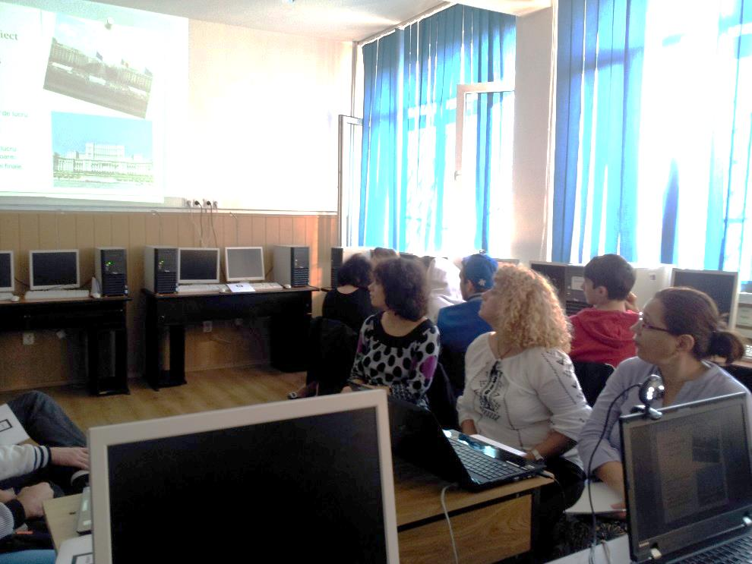
This activity was used to disseminate the EVTUM project: objectives, activities, meetings and site
Students were invited to present some examples of virtual companies in order to facilitate the exchange of good practices in using unconventional methods in VET;

Slide 8
Activities on 10th october

Slide 9
Teachers held a workshop on developing unconventional teaching methods and exchanging practical ideas of using unconventional methods in the teaching/learning process;
The workshop had two parts: presentations of examples of unconventional methods and the second part – working in teams and brainstorming ideas of extracurricular activities that can be developed in order to complete the traditional formal training. At the end of the activity, teachers could present their ideas and had a debate upon them.

Slide 10
Teachers presenting their ideas of unconventional teaching methods

Slide 11
Activities on 11th october

Slide 12
A workshop with students of vocational and technical education and representatives of different companies and firms was organised.
Representatives of different companies presented their companies: characteristic of the firms, the profile of their employees, hiring process, companies’ expectations from the employees, etc.
The trainees could ask questions to the representatives

Slide 13
Dissemination OF OUTDOOR ACTIVITIES
Municipal Meeting of the school inspectors on different specializations;
Meeting of school principals;
Meetings of teachers of different technical specializations;
Municipal Conference of school deputy inspectors

