Slide 1




THE PROFESSION MOST IN DEMAND IN ROMANIA
Meeting in Italy
27 – 29 January 2014

Slide 2
According to the data offered by the National Agency of Employment, the top 10 most demanded professions for high education graduates in Romania in 2013 are:

Slide 3
IT SPECIALIST
SALES REPRESENTATIVE
MANAGER/CONSULTANT
ENGINEER
MANAGER ASSISSTANT
NETWORK ADMINISTRATOR
ACCOUNTANT
FINANCIAL CONSULTANT
MEDICAL DOCTOR
TOURISM AGENT

Slide 4
IT SPECIALIST
IT companies in Romania lose a lot of money every year as they turn down contracts because of the lack of employees who have the necessary competences and abilities to work.
Moreover, the competition for the new employees in IT domain is so high that the salaries are at least two times higher than the national average for a beginner and the employees have the freedom to migrate from one company to another for a better offer.

Slide 5
The universities that train specialists in the IT field have 10,000 graduates every year although the necessary number would be double, as the other type of universities have graduates who can hardly be absorbed in the labour market, therefore they become unemployed.

Slide 6
According to Călin Văduva, the founder and owner of Fortech, one of the most important companies of IT outsourcing in Cluj-Napoca, there is an imbalance on the labour market between the university graduates and the employers’ needs of personnel.

Slide 7
In 2009 – IT labour market suffered a reorganization;
In 2010 - IT labour market became stable;
In 2011 and 2012 - IT labour market grew steadily;
In 2013 – 120,000 employees work in IT&C field, with 1,000 employees more than previous years, based on the development on hardware and software sectors, which compensated the loses of personnel from the telecommunication companies

Slide 8
Companies such as: Oracle, IBM, HP, Ubisoft, Gameloft and Computaris are just few examples of companies that have significantly increased their teams in the last years

Slide 9
According to the National Commission of Prognosis, the average salary in Romania can reach the level of 532 euro in 2014, but the computer programmers can earn twice or more than this sum.
Although it is one of the most well-paid jobs in present times, every year, there are still vacant positions of IT specialists which shows the imbalance between the needs of the labour market and the offers of the education field.

Slide 10

The most wanted qualifications which are offered by the Romanian professional and technical education are:
In the field of services:
Chef- one of the professions most in demand due to the nature of the activity, as well as to the expected incomes when there is qualification in various cooking styles – salaries are between 700 and 1500 euro

Slide 11
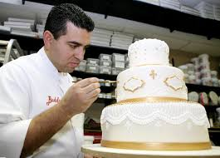
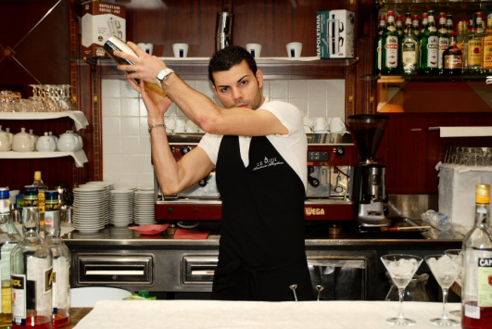
In the field of services:
Confectioner– pastry cook
The salary of a confectioner starts from 500 euro and can reach even 1000 euro or more according to the complexity of specialization.
Bartender
The income for this activity varies according to the location of the bar where he works and can be between 800 and over 1500 euro. The advantage is the direct interaction with the clients which leads to the significant raise of the income with the help of the tips.

Slide 12
Waiter- Although the salaries varies between 800 and 1000 Ron, the tips help the income raise to 1500-2000 Ron
Receptionist- The tourism domain offers the possibility of specialization in direct contact with clients, the receptionist being the first who welcomes you and the last who says goodbye to you in a hotel. The incomes varies between 1000 to 3000 Ron, and the direct contact with the clients can lead to other financial benefits.
Touristic guide – tourism is based on those people who know how to take the clients to those places worth visiting in the country and abroad. The main advantage is that the agents visit a lot of places, travel a lot. The incomes are as spectacular as this. The incomes starts from 800 Ron, in case of experienced guides can be more than 3000 Ron.

Slide 13


In the field of services:
Hair stylist- This job combines passion for cosmetic domain with the artistic sense of each person which are essential for a successful hair stylist.
Beautician – The incomes varies between hundreds of euro to over 1000 euro, especially if the activity takes place abroad.
Sales assistant – this activity consists of permanent relationship with customers, so this activity requires very good communication skills. The incomes varies between 800 ron to over 2000 Ron.

Slide 14


Babysitter
In MEDIA field:
Photographer
Cameraman
It belongs to the artistic field and it involves great financial investment in equipment, but the incomes are as great. The salary for this position can start from 1000 Ron and grows according to specialization and experience.
Activity which requires a person with great abilities in working with children and a lot of patience. The incomes varies according to the employee’s qualification between 250 and1000 euro.
The incomes can reach more that 1000 euro per month, according to the type and number of events .

Slide 15

In the field MECHANIC
Welder
A job which requires physical strength and resistance to a tough working environment. The incomes in this field can reach 1500 euro in Romania, while in other UE countries it can reach 3000 euro. These earnings can grow substantially if the welder is specialized in argon welding and for this case the salary can reach 4000 euro in Romania and much more abroad.

Slide 16
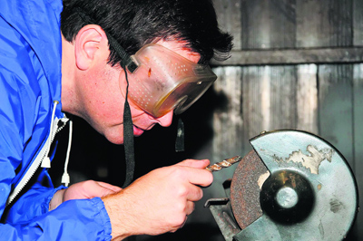
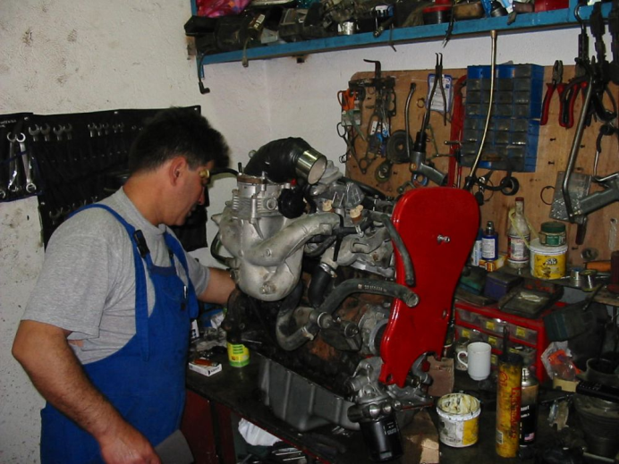
In the field MECHANIC
Locksmith
The incomes can reach 1500 euro in România, and 3000 euro abroad.
Car mechanic, driver
The job of driver can be very flexible and this is why it gets interesting for the people whose qualification is no longer required on the labour market or for those without a qualification.
The incomes of a driver vary from 500 euro in Romania, to over 1500-2000 euro for the truck drivers who go abroad.

Slide 17
THANK YOU

